Slide 1
Introduction to PostGIS
Ulanbek turdukulov

Slide 2

Spatial Objects for PostgreSQL
Adds support for geographic objects to the PostgreSQL object-relational database
PostgreSQL already has “geometric types” but native geometries are too limited for GIS data and analysis

Slide 3
Why PostGIS?
Because databases are better than files
Unified Storage, Management, Access
  SQL Everywhere
Transactional Integrity
  Multiple Users, Multiple Edits
Notes:
Ah the siren song of the technology bigot!
Databases are not better than files. Databases are more expensive than files. But more expensive does not equal better.
Database do some things better than files.
Support multiple users editing and accessing the same data at the same time.
Support large data volumes better than files. (For some kinds of data.)
Provide a unified means of accessing and analysing data. SQL.
Provide a unified means of access control for data. Fine grained.
Provide an integration point for spatial data (formerly isolated in “GIS world”) and enterprise data (long-time resident of database world).

Slide 4
PostGIS in the Spatial Stack
LAN
Internet
Mapserver
uDig
OpenIMF
PostGIS
GeoServer
QGIS
Web
Client
MapGuide
GRASS
uDig
ArcGIS

Slide 5
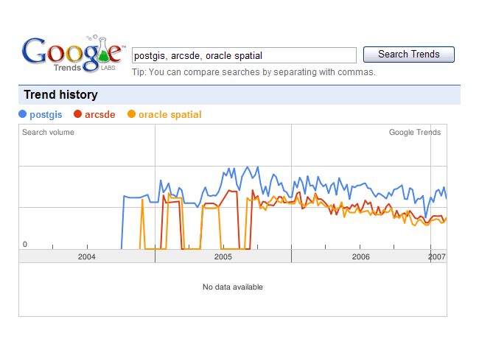
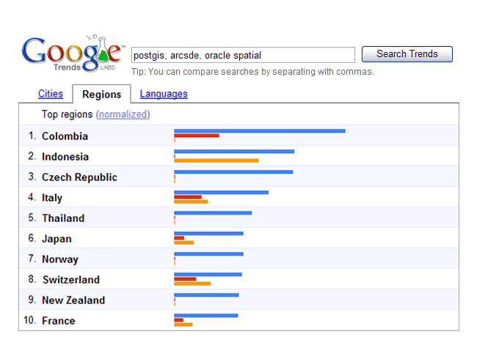
Who is using PostGIS?
Lots of people …
1400 mailing list members
14K visits/month
10K visitors/month
100 source code downloads per day
100 windows binary downloads per day
970K Google search results
Great Google trends …
Notes:
The popularity of PostGIS continues to grow every year! While there is no such thing as "sales figures" for an open source project, there are at least statistics about web site use, code downloads, and so on. Here are the current numbers!

Slide 6
Who is using PostGIS?
North Dakota State Water Commission in Bismark uses PostGIS as the cost-effective foundation for managing the use of state-wide water resources. PostGIS tied unobtrusively into their existing desktop systems and pre-empted a costly migration to an ArcIMS/ArcSDE system.

Slide 7
Who is using PostGIS?
The Ministry of Sustainable Resource Management (British Columbia, Canada) uses PostGIS to store, manage and analyze their Digital Road Atlas, a large and complex road network database.

Slide 8
Who is using PostGIS?
Institut Géographique National (IGN France) uses PostGIS to underpin a system containing more than 100 million spatial objects, including a 3D national database of roads, rails, hydrography, vegetation, buildings and administrative boundaries.

Slide 9
Who is using PostGIS?
InfoTerra (United Kingdom) uses PostGIS to store >600 million features of topographic data. Sits at the back-end of their online DataStore. Notable load times of 12 hours for the entire data-suite ~14000 features per second. More notable savings of ~£1000000 per annum.

Slide 10
Workshop Summary
Installation (PostgreSQL and PostGIS)
System Configuration
Creating and Loading Data
Creating Indexes
Query Tuning
Spatial SQL

Slide 11
2.1 – PostgreSQL Installation
Windows Installer
  PostgreSQL 8.2.4
  PgAdmin III
Install as Service to allow automatic database start on boot
Demonstrate Installation …
Notes:
The PostgreSQL installation package is in the CDROM at Software\Windows\PostgreSQL\.
Double-click the postgresql-8.2.msi file.
The installer will start up. Choose your language and follow the installation instructions.
When the “Installation options” selector comes up, choose to enable the PostGIS extension.
You will have to select an account the run PostgreSQL under. The default “postgres” user name is standard.
If you plan on accessing PostgreSQL from any machine other than the machine you are installing it on, you have to check “Accept connections on all addresses” box. The default locale and encoding are good for English.
Even if you accept connections in principle, you will have to specifically indicate which hosts or networks you will accept connections from by editing a configuration file. This is covered later in the workshop.
The PL/PgSQL language is required for PostGIS, so ensure it is selected. PL/Perl is handy for Perl programmers who want to write triggers and functions in Perl, but not required by PostGIS.
The B-Tree GIST, Fuzzy String Match, and Tsearch2 modules might come in handy if you work with PostgreSQL enough to become a power user.
If you enable PostGIS in “template1”, then all of your databases in PostgreSQL will be spatially enabled. This is not necessarily a bad thing, but it means your databases will have extra functions and dependencies in them that you might not want or need if your database uses no spatial objects. Leave this option unchecked, we will cover manually enabling PostGIS in the workshop.
That is it for decisions! Complete your installation.

Slide 12
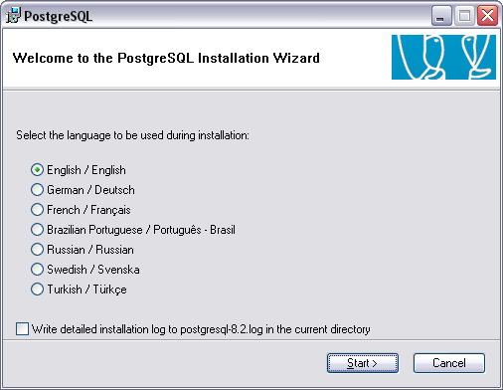
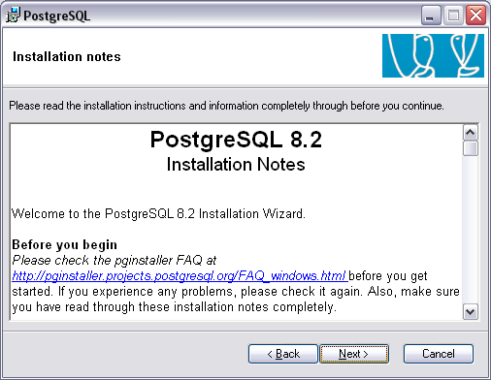
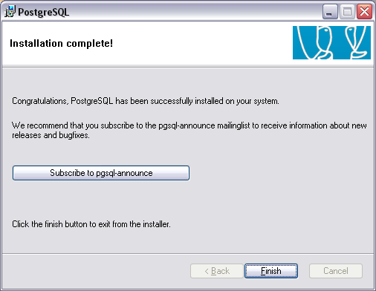
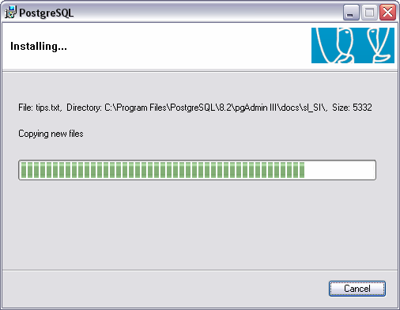
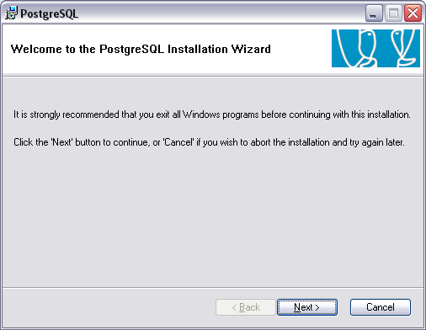
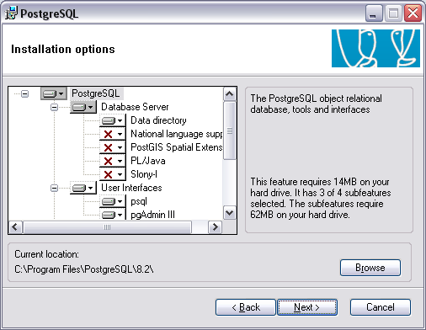
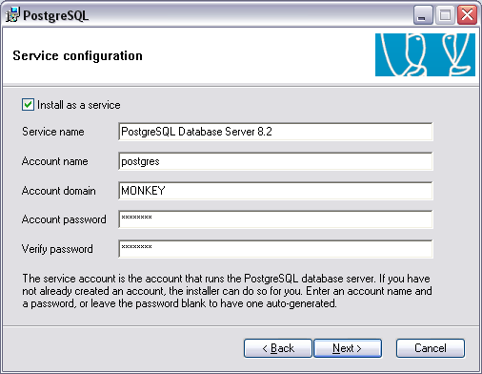
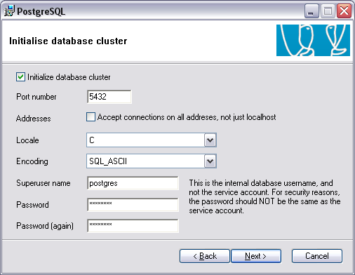
2.1 – PostgreSQL Installation

Slide 13
2.1 – PostgreSQL Installation
Directories created during installation:
  \bin - Executables
  \include - Include files for compilation
  \lib - DLL shared library files
  \share - Extensions

Slide 14
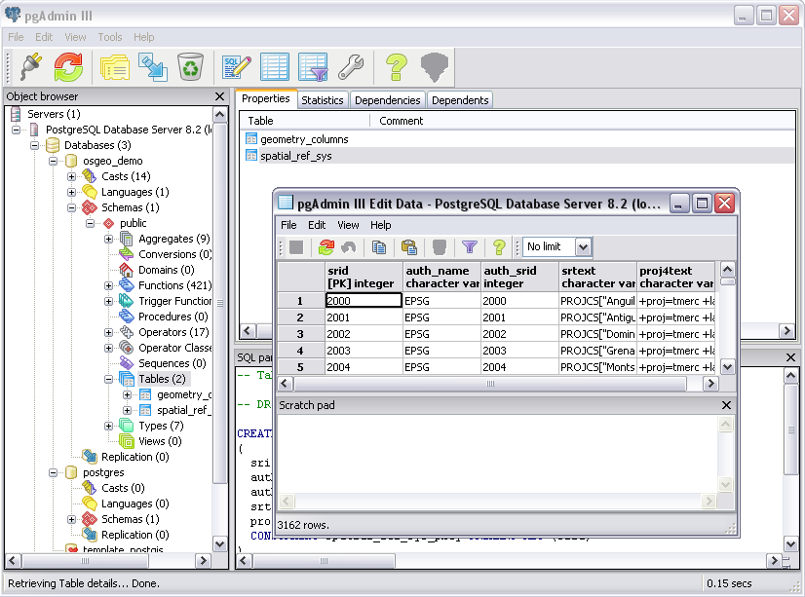
2.1 – PostgreSQL Installation
Tools included with the install:
PgAdmin III
psql Command Line

Slide 15
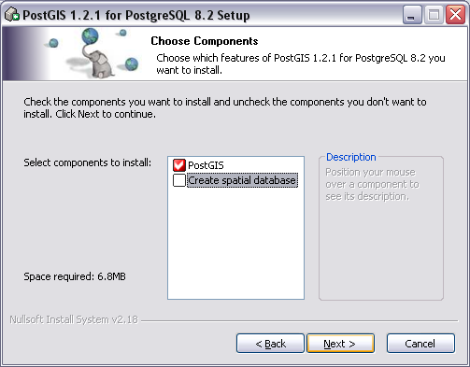
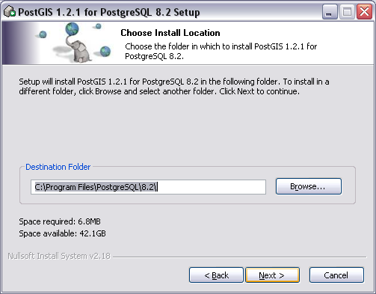
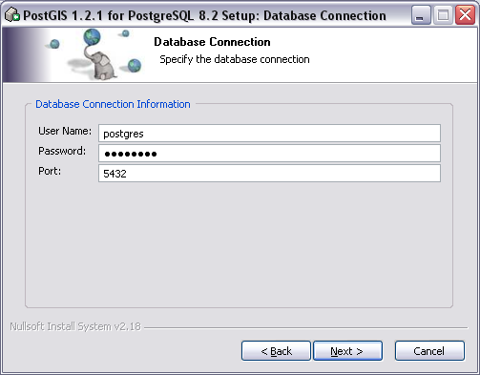
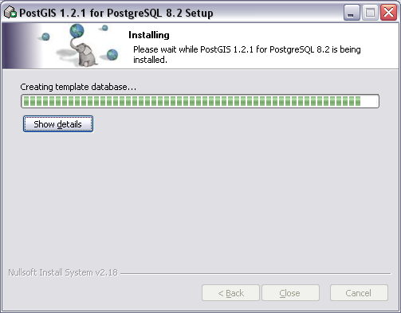
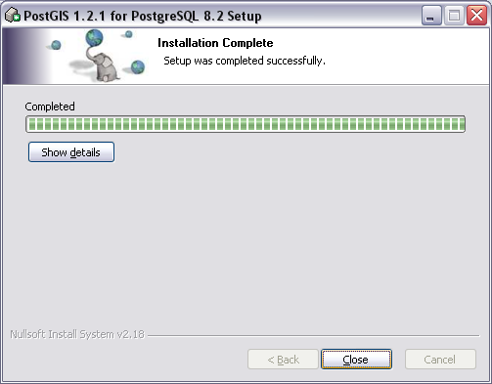
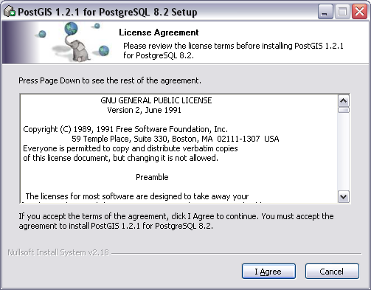
2.2 – PostGIS Installation

Slide 16
2.2 – PostGIS Installation
PostGIS bundled with PostgreSQL lags the current release by a few versions
Current release is 1.5.2
(1.1.x is bundled with PostgreSQL)
Our Lab
Already has PostgreSQL installed
Already has PostGIS installed
We need to create an empty spatial database
Notes:
The PostGIS installation package is in the CDROM at Software\Windows\PostgreSQL\postgis-pg82-setup-1.2.2.exe
Run postgis-pg82-setup-1.2.2.exe
Deselect ‘Create Database’ option; we will do this later.
Accept the default PostgreSQL path.
‘Database Connection’ page collects login information for the ‘Create Database’ option. We don’t need to fill it in.
Click ‘Install’

Slide 17
2.2 – PostGIS Installation
A PostgreSQL instance has one software version and one network port (5432)
An instance contains many databases
  Connection string specifies a database
  “-h host –U user –d database –p password”
A database contains many schemas
  public
A schema contains many tables
  public.geometry_columns
A table contains many tuples
Notes:
The PostGIS installation package is in the CDROM at Software\Windows\PostgreSQL\postgis-pg82-setup-1.2.2.exe
Run postgis-pg82-setup-1.2.2.exe
Deselect ‘Create Database’ option; we will do this later.
Accept the default PostgreSQL path.
‘Database Connection’ page collects login information for the ‘Create Database’ option. We don’t need to fill it in.
Click ‘Install’

Slide 18
2.3 – Spatially Enable PostgreSQL
Connect to the instance
  User “postgres”, password “postgres”
Create a new database in our local instance
  Select “template_postgis” as the template
Connect to the database
Check for the spatial system tables
  spatial_ref_sys
  geometry_columns
Notes:
The installer will set up a PostgreSQL menu in your start menu.
Go to the PostgreSQL menu and run PgAdmin III.
Double click on the “PostgreSQL Database Server” tree entry. You will be prompted for the super user password to connect to the “template1” database.
Navigate to the “Databases” section of the database tree and open “Edit ⇨ New Object ⇨ New Database”. Add a new database named “postgis”, with “postgres” as the owner “template1” as the template and “pg_default” as the tablespace.
Open up the new “postgis” database tree and navigate to the languages. Check that PL/PgSQL is already installed. This language is needed for PostGIS.
Now we are ready to install PostGIS. Open up the SQL window by clicking the SQL button (the one with the pencil).
Choose “File ⇨ Open…” and navigate to
C:\Program Files\PostgreSQL\8.1\contrib\share\lwpostgis.sql
Press the “Run” button. (The green triangle.) The postgis.sql file will execute, loading the PostGIS functions and objects into the “postgis” database.
Choose “File ⇨ Open…” and navigate to
C:\Program Files\PostgreSQL\8.1\contrib\share\spatial_ref_sys.sql
Press the “Run” button again. The spatial_ref_sys.sql file will execute, loading the EPSG coordinate reference systems into the PostGIS spatial reference table.

Slide 19
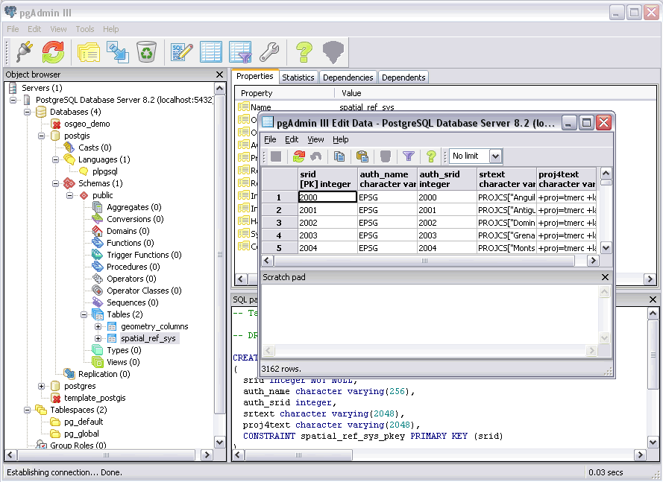
2.3 – Spatially Enable PostgreSQL
Notes:
The installer will set up a PostgreSQL menu in your start menu.
Go to the PostgreSQL menu and run PgAdmin III.
Double click on the “PostgreSQL Database Server” tree entry. You will be prompted for the super user password to connect to the “template1” database.
Navigate to the “Databases” section of the database tree and open “Edit ⇨ New Object ⇨ New Database”. Add a new database named “postgis”, with “postgres” as the owner “template1” as the template and “pg_default” as the tablespace.
Open up the new “postgis” database tree and navigate to the languages. Check that PL/PgSQL is already installed. This language is needed for PostGIS.
Now we are ready to install PostGIS. Open up the SQL window by clicking the SQL button (the one with the pencil).
Choose “File ⇨ Open…” and navigate to
C:\Program Files\PostgreSQL\8.1\contrib\share\lwpostgis.sql
Press the “Run” button. (The green triangle.) The postgis.sql file will execute, loading the PostGIS functions and objects into the “postgis” database.
Choose “File ⇨ Open…” and navigate to
C:\Program Files\PostgreSQL\8.1\contrib\share\spatial_ref_sys.sql
Press the “Run” button again. The spatial_ref_sys.sql file will execute, loading the EPSG coordinate reference systems into the PostGIS spatial reference table.

Slide 20
2.3.1 – Without template_postgis
Create a new database
  Select “template1” as the template
Connect to the database
Load/run the PostGIS extension (lwpostgis.sql)
Load/run the PostGIS spatial reference systems (spatial_ref_sys.sql)
Notes:
The installer will set up a PostgreSQL menu in your start menu.
Go to the PostgreSQL menu and run PgAdmin III.
Double click on the “PostgreSQL Database Server” tree entry. You will be prompted for the super user password to connect to the “template1” database.
Navigate to the “Databases” section of the database tree and open “Edit ⇨ New Object ⇨ New Database”. Add a new database named “postgis”, with “postgres” as the owner “template1” as the template and “pg_default” as the tablespace.
Open up the new “postgis” database tree and navigate to the languages. Check that PL/PgSQL is already installed. This language is needed for PostGIS.
Now we are ready to install PostGIS. Open up the SQL window by clicking the SQL button (the one with the pencil).
Choose “File ⇨ Open…” and navigate to
C:\Program Files\PostgreSQL\8.1\contrib\share\lwpostgis.sql
Press the “Run” button. (The green triangle.) The postgis.sql file will execute, loading the PostGIS functions and objects into the “postgis” database.
Choose “File ⇨ Open…” and navigate to
C:\Program Files\PostgreSQL\8.1\contrib\share\spatial_ref_sys.sql
Press the “Run” button again. The spatial_ref_sys.sql file will execute, loading the EPSG coordinate reference systems into the PostGIS spatial reference table.

Slide 21
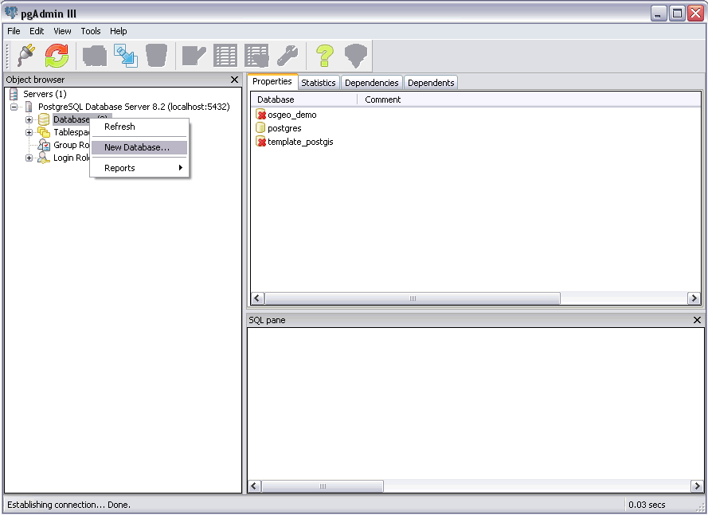
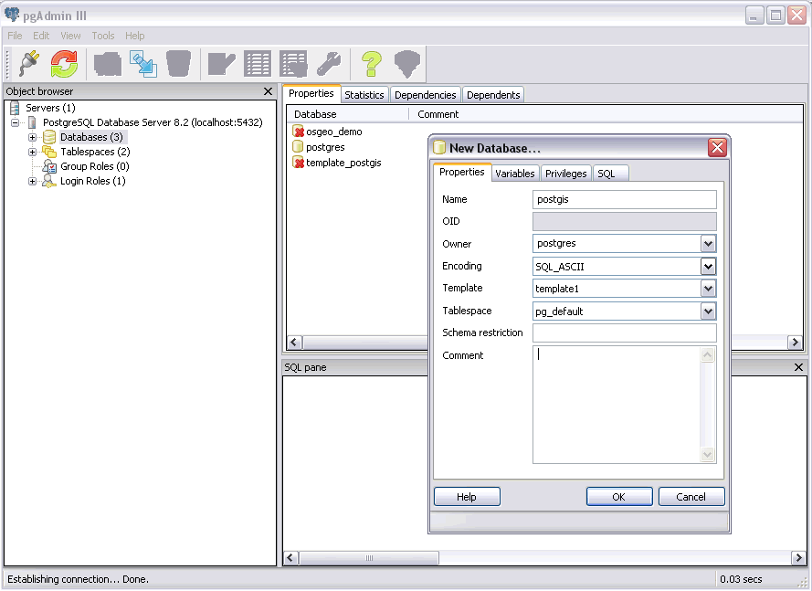
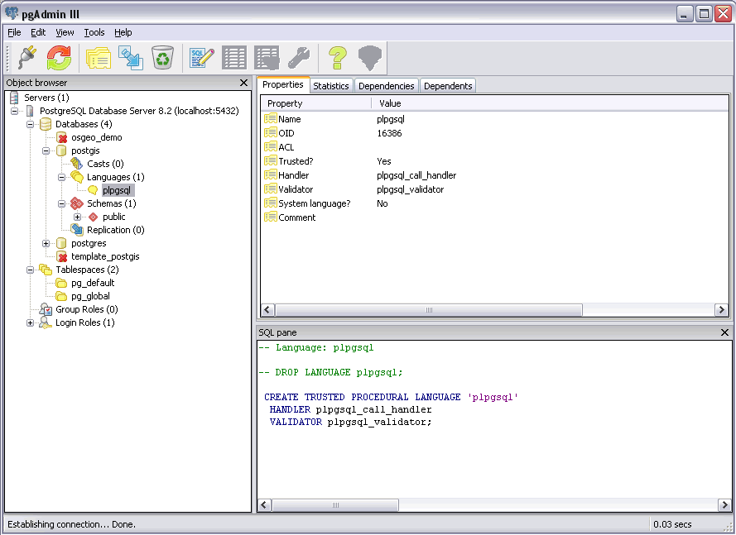
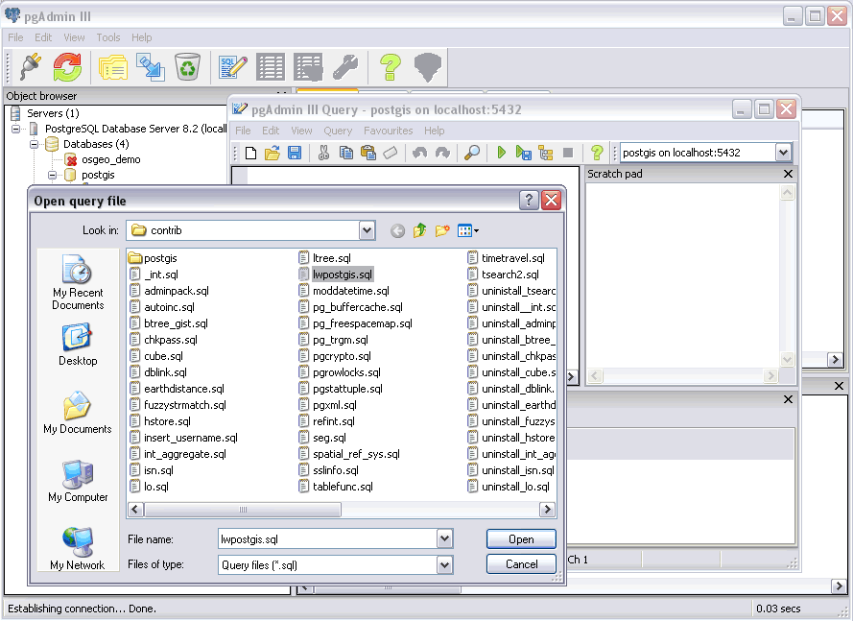
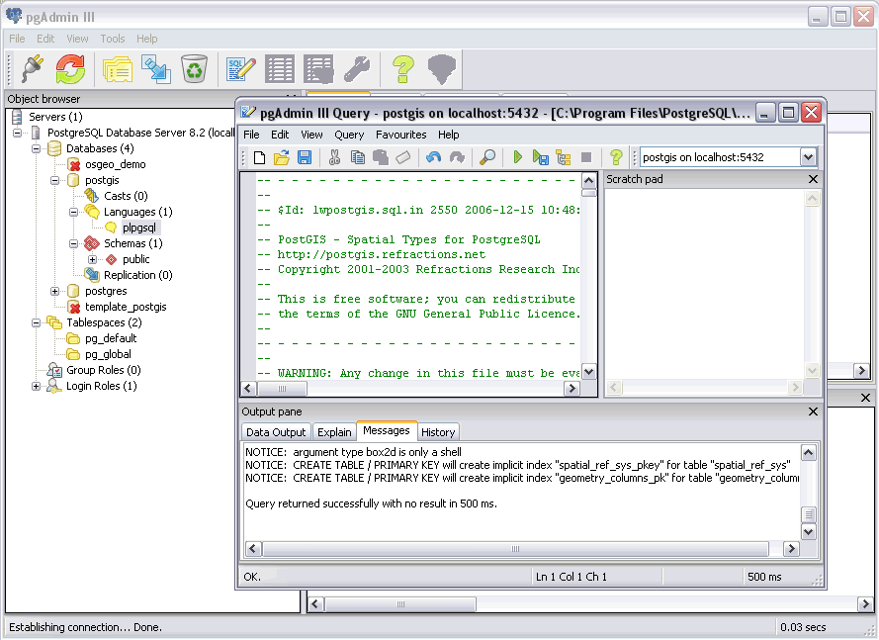
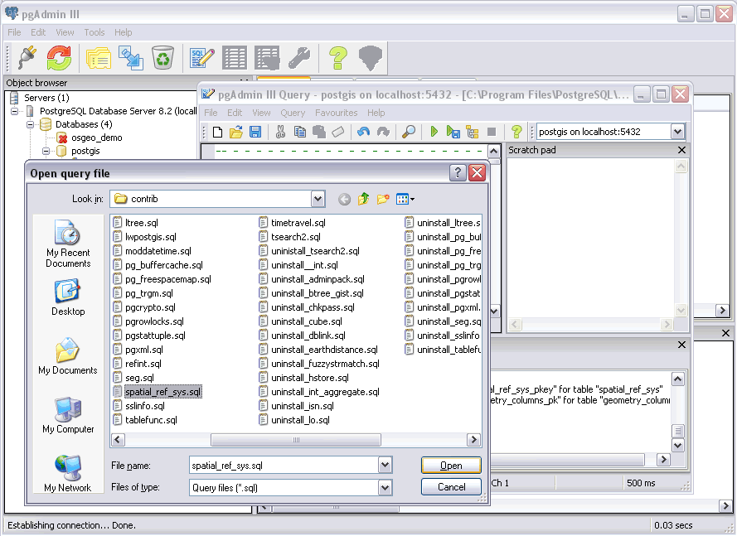
2.3.1 – Without template_postgis
Run PG Admin III …
Notes:
The installer will set up a PostgreSQL menu in your start menu.
Go to the PostgreSQL menu and run PgAdmin III.
Double click on the “PostgreSQL Database Server” tree entry. You will be prompted for the super user password to connect to the “template1” database.
Navigate to the “Databases” section of the database tree and open “Edit ⇨ New Object ⇨ New Database”. Add a new database named “postgis”, with “postgres” as the owner “template1” as the template and “pg_default” as the tablespace.
Open up the new “postgis” database tree and navigate to the languages. Check that PL/PgSQL is already installed. This language is needed for PostGIS.
Now we are ready to install PostGIS. Open up the SQL window by clicking the SQL button (the one with the pencil).
Choose “File ⇨ Open…” and navigate to
C:\Program Files\PostgreSQL\8.1\contrib\share\lwpostgis.sql
Press the “Run” button. (The green triangle.) The postgis.sql file will execute, loading the PostGIS functions and objects into the “postgis” database.
Choose “File ⇨ Open…” and navigate to
C:\Program Files\PostgreSQL\8.1\contrib\share\spatial_ref_sys.sql
Press the “Run” button again. The spatial_ref_sys.sql file will execute, loading the EPSG coordinate reference systems into the PostGIS spatial reference table.

Slide 22
3 Using PostGIS

Slide 23
3.1 – Simple Spatial SQL
“Manually” create geometries
create table points (pt geometry, name varchar);
insert into points values ('POINT(0 0)', 'Origin');
insert into points values ('POINT(5 0)', 'X Axis');
insert into points values ('POINT(0 5)', 'Y Axis');
select name, ST_AsText(pt),
ST_Distance(pt, 'POINT(5 5)') from points;
Notes:
There are two spatial database functions being used in the example above: Distance() and AsText(). Both functions expect geometry objects as arguments. The Distance() function calculates the minimum Cartesian distance between two spatial objects. The AsText() function turns geometry into a simple textual representation, called “Well-Known Text”.

Slide 24
3.1 – Simple Spatial SQL
name | astext | distance
--------- + -------------- + ------------------
Origin | POINT(0 0) | 7.071067
X Axis | POINT(5 0) | 5
Y Axis | POINT(0 5) | 5
(3 rows)
Notes:
There are two spatial database functions being used in the example above: Distance() and AsText(). Both functions expect geometry objects as arguments. The Distance() function calculates the minimum Cartesian distance between two spatial objects. The AsText() function turns geometry into a simple textual representation, called “Well-Known Text”.

Slide 25
3.2 OGC Metadata Tables
GEOMETRY_COLUMNS
  F_TABLE_CATALOG = ‘’
  F_TABLE_SCHEMA = ‘public’
  F_TABLE_NAME = ‘bc_roads’
  F_GEOMETRY_COLUMN = ‘the_geom’
  COORD_DIMENSION = 2
  SRID = 3005
  TYPE = ‘MULTILINESTRING’

Slide 26
3.2 OGC Metadata Tables
SPATIAL_REF_SYS
  SRID = 3005
  AUTH_NAME = ‘EPSG’
  AUTH_SRID = 3005
  SRTEXT = ‘PROJCS["NAD83 / BC Albers”, … ]’
  PROJ4TEXT = ‘+proj=aea …’

Slide 27
3.3 – Loading Shape Files
Shape File
  .shp = geometry
  .dbf = attributes (string, number, date)
  .shx = utility index
PostGIS/PostgreSQL Table
  Columns can be geometry
  Columns can be attributes
One Shape File = One PostGIS Table

Slide 28
3.3 – Loading Shape Files
shp2pgsql [opts] shapefile tablename
Read in .shp file
Write out .sql file
Load .sql file into PostgreSQL
  using psql
  using PgAdmin
Notes:
Now we will load our example data (C:\workshop\data) into the database.
The sample data is in Shape files, so we will need to convert it into a loadable format using the shp2pgsql tool and then load it into the database.
Run the pg_setenv.bat file first, to add the PostgreSQL install data to your path, so you can easily use the shp2pgsql tool.
Our data is in projected coordinates, the projection is “BC Albers” and is stored in the SPATIAL_REF_SYS table as SRID 3005. When we create the loadable format, we will specify the SRID on the command line, so that the data is correctly referenced to a coordinate system. This will be important later when we try the coordinate re-projection functionality.
We may either create the load format as a file, then load the file with psql, or pipe the results of shp2pgsql directly into the psql terminal monitor. We will use the first option for the bc_pubs data, and then bulk load the remaining data.
pg_setenv.bat
shp2pgsql -s 3005 bc_pubs.shp bc_pubs > bc_pubs.sql
pg_shpsql.bat
psql –U postgres –f bc_data.sql –d postgis

Slide 29
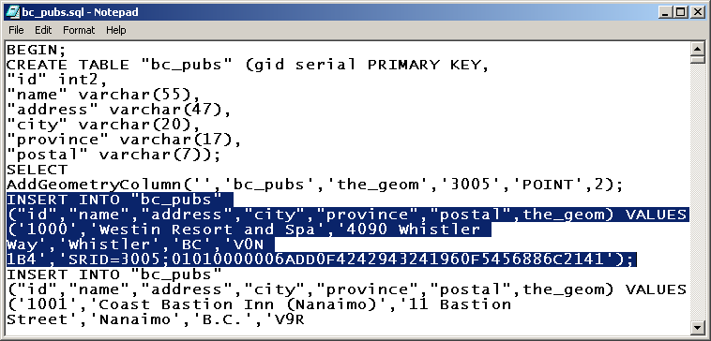
3.3 – Loading Shape Files
notepad bc_pubs.sql
Notes:
Now we will load our example data (C:\workshop\data) into the database.
The sample data is in Shape files, so we will need to convert it into a loadable format using the shp2pgsql tool and then load it into the database.
Run the pg_setenv.bat file first, to add the PostgreSQL install data to your path, so you can easily use the shp2pgsql tool.
Our data is in projected coordinates, the projection is “BC Albers” and is stored in the SPATIAL_REF_SYS table as SRID 3005. When we create the loadable format, we will specify the SRID on the command line, so that the data is correctly referenced to a coordinate system. This will be important later when we try the coordinate re-projection functionality.
We may either create the load format as a file, then load the file with psql, or pipe the results of shp2pgsql directly into the psql terminal monitor. We will use the first option for the bc_pubs data, and then bulk load the remaining data.
pg_setenv.bat
shp2pgsql -s 3005 bc_pubs.shp bc_pubs > bc_pubs.sql
pg_shpsql.bat
psql –U postgres –f bc_data.sql –d postgis

Slide 30
3.3.1 – Command Line Options
-D = Use “dump” format
-i = Do not use “bigint”, even for long numbers
-s <#> = Use this SRID
-W <encoding> = Use this character encoding
-a = Run in append mode
Notes:
Now we will load our example data (C:\workshop\data) into the database.
The sample data is in Shape files, so we will need to convert it into a loadable format using the shp2pgsql tool and then load it into the database.
Run the pg_setenv.bat file first, to add the PostgreSQL install data to your path, so you can easily use the shp2pgsql tool.
Our data is in projected coordinates, the projection is “BC Albers” and is stored in the SPATIAL_REF_SYS table as SRID 3005. When we create the loadable format, we will specify the SRID on the command line, so that the data is correctly referenced to a coordinate system. This will be important later when we try the coordinate re-projection functionality.
We may either create the load format as a file, then load the file with psql, or pipe the results of shp2pgsql directly into the psql terminal monitor. We will use the first option for the bc_pubs data, and then bulk load the remaining data.
pg_setenv.bat
shp2pgsql -s 3005 bc_pubs.shp bc_pubs > bc_pubs.sql
pg_shpsql.bat
psql –U postgres –f bc_data.sql –d postgis

Slide 31
3.4 Viewing Data in PostGIS
Quick desktop viewing options
  uDig
  QGIS
  gvSIG
  CadCorp SIS*
  FME Viewer*
Web based application options
  MapGuide
  Mapserver
  Geoserver

Slide 32
3.4 Viewing Data in PostGIS
Program Files ⇒ uDig 1.1-RC11 ⇒ uDig

Slide 33
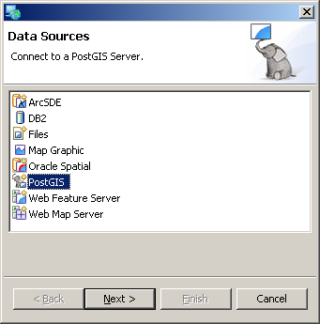
3.4 Viewing Data in PostGIS
File ⇒ New ⇒ Layer

Slide 34
3.4 Viewing Data in PostGIS

Slide 35
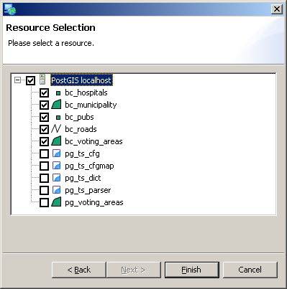
3.4 Viewing Data in PostGIS

Slide 36
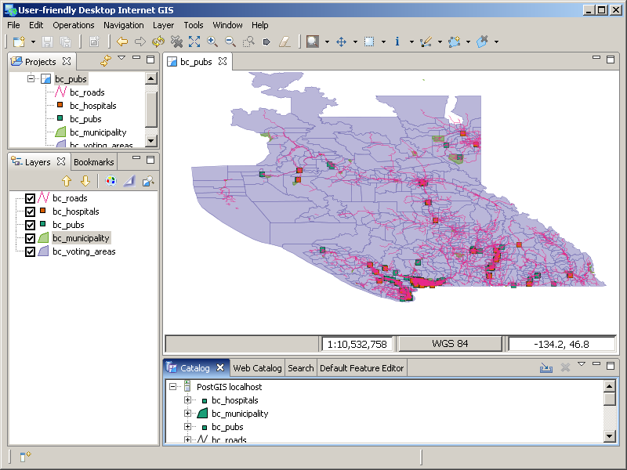
3.4 Viewing Data in PostGIS

Slide 37
3.5.1 Creating Spatial Indexes
PostGIS implements R-Tree indexes on top of the GiST indexing system
Organizes data into nesting rectangles for fast searching
CREATE INDEX bc_roads_gidx ON bc_roads USING GIST (the_geom);
(now create indexes on the other tables too…)
Notes:
B-Tree indices are used on data that can be sorted along a single axis using a straightforward greater-than/less-than/equal comparison. This doesn’t lend itself to GIS data, as it must be sorted along two or more axes.
R-Tree indices break data recursively into rectangles. This allows efficient searching of multidimensional data, and as such is used by so spatial databases.
GiST indices break data into “things to one side”, “things that overlap” and “things contained within,” making GiST indexing very flexible. PostGIS uses an R-Tree indexing scheme built on top of the GiST framework.

Slide 38
3.5.2 Using Spatial Indexes
Indexes are brought into play when PostgreSQL recognizes an “operator” in the SQL statement. For example:
SELECT * FROM mytable
WHERE myname = ‘Paul’
  = is an operator
SELECT * FROM mytable
WHERE age < 2
  < is an operator
Notes:
B-Tree indices are used on data that can be sorted along a single axis using a straightforward greater-than/less-than/equal comparison. This doesn’t lend itself to GIS data, as it must be sorted along two or more axes.
R-Tree indices break data recursively into rectangles. This allows efficient searching of multidimensional data, and as such is used by so spatial databases.
GiST indices break data into “things to one side”, “things that overlap” and “things contained within,” making GiST indexing very flexible. PostGIS uses an R-Tree indexing scheme built on top of the GiST framework.

Slide 39
3.5.2 Using Spatial Indexes
Spatial index operator is “&&”
  “Bounding Boxes Interact”
A && B = TRUE
A && B = FALSE

Slide 40
3.5.2 Using Spatial Indexes
Bounding Boxes are not enough!
Two pass system required
  Use bounding boxes to reduce candidates
  Use real topological test to get final answer
A && B = TRUE
_ST_Intersects(A && B) = FALSE

Slide 41
3.5.2 Using Spatial Indexes
ST_Intersects(A,B)
A && B AND _ST_Intersects(A,B)

Slide 42
3.5.2 Using Spatial Indexes
A && B

Slide 43
3.5.2 Using Spatial Indexes
A && B

Slide 44
3.5.2 Using Spatial Indexes
_ST_Intersects(A,B)

Slide 45
3.5.2 - Using Spatial Indexes
Index operations (&&) are built into common functions for automatic use, but you can use them separately if you like.
  ST_Intersects(G1,G2)
    G1 && G2 AND _ST_Intersects(G1,G2)
  ST_Contains(G1,G2)
  ST_Within(G1,G2)
  ST_Touches(G1,G2)
  ST_DWithin(G1,G2,D)
    G1 && ST_Expand(G2,D) AND
    ST_Distance(G1,G2) > D

Slide 46
3.5.3 - Spatial Index Test
Run query with un-indexed function
  SELECT gid, name FROM bc_roads
  WHERE _ST_Crosses( the_geom,
  ST_GeomFromText(‘..’, 3005) );
Run query with indexed function
  SELECT gid, name FROM bc_roads
  WHERE ST_Crosses( the_geom,
  ST_GeomFromText(‘..’, 3005) );
Note speed difference

Slide 47
3.5.4 - Indexes and Query Plans
Run queries using the “Explain”
button instead of the “Run”
button
Note the graphical display of how the database is using indexes
Click on the icons to get more information about each step of the query
Remember to try this later when we start performing more complicated queries

Slide 48
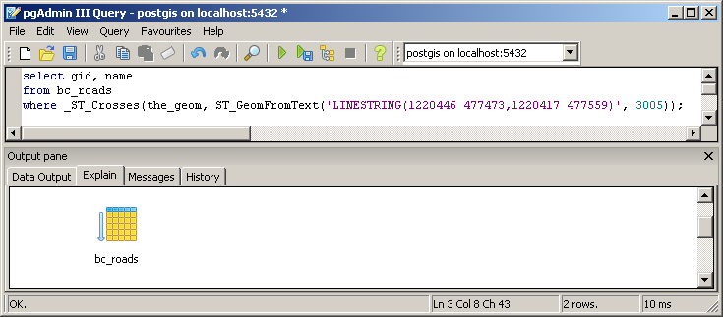
3.5.4 - Indexes and Query Plans

Slide 49
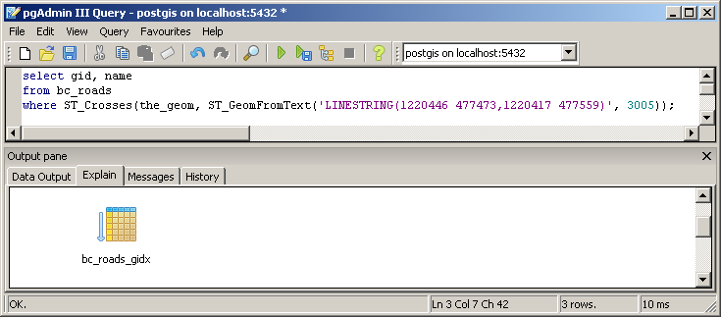
3.5.4 - Indexes and Query Plans

Slide 50
3.5.5 - When Query Plans go Bad
The database builds “plans” based on statistics about data distribution sampled from the tables
  Always tries to be “selective”, to pull the fewest number of records necessary to move on to the next step
The database builds bad plans when it has bad statistics
Make sure your database has up-to-date statistics by running ANALYZE

Slide 51
3.6 - PostgreSQL Optimization
PostgreSQL settings are controlled by the postgresql.conf file
Programs =>
PostgreSQL 8.2 =>
Configuration Files =>
Edit postgresql.conf
Some settings require a restart
Some can be changed at run-time using the SET command!

Slide 52
3.6 - PostgreSQL Optimization
PostgreSQL ships with conservative settings
  Uses very little memory
  Runs on very limited hardware
Disk access is slow, so higher performance can be gained by using more memory to cache data!
  Increase shared_buffers
  Physical RAM - OS needs * 75%

Slide 53
3.6 - PostgreSQL Optimization
Sorting is faster in memory
  Increase work_mem
Disk clean-up is faster with more memory
  Increase maintenance_work_mem
Allocated per connection
Also
  Increase wal_buffers
  Increase checkpoint_segments
  Decrease random_page_cost

Slide 54
3.7 - Spatial Analysis in SQL
Get out the data dictionary, flip to the back:
ST_Length(geometry) returns Float
ST_Area(geometry) returns Float
ST_AsText(geometry) returns Text
ST_GeomFromText(text) returns Geometry

Slide 55
3.7 - Spatial Analysis in SQL
ST_Intersects(A, B)

Slide 56
3.7 - Spatial Analysis in SQL
ST_Contains(A, B)
ST_Within(B, A)

Slide 57
3.7 - Spatial Analysis in SQL
ST_Touches(A, B)

Slide 58
3.7 - Spatial Analysis in SQL
ST_Crosses(A, B)

Slide 59
3.7 - Spatial Analysis in SQL
ST_DWithin(A, B, D)
D

Slide 60
3.7 - Spatial Analysis in SQL
What is the total area of all landslides in kilometers (using Guass Kruger projection?
SELECT
Sum( ST_Length( the_geom ) ) / 1000
AS km_roads
FROM bc_roads;

Slide 61
3.7 - Spatial Analysis in SQL
What is the largest municipality in the province, by area?
SELECT
name,
ST_Area(the_geom)/10000
AS hectares
FROM bc_municipality
ORDER BY hectares DESC
LIMIT 1;

Slide 62
3.8 - Basic Exercises
What is the perimeter of the municipality of ‘VANCOUVER?’
Hint – name = ‘VANCOUVER’
SELECT ST_Perimeter(the_geom)
FROM bc_municipality
WHERE name = 'VANCOUVER';

Slide 63
3.8 - Basic Exercises
What is the total area of all voting areas in hectares?
Hint – 1 hectare = 10,000 m²
SELECT Sum(ST_Area(the_geom))/10000
AS hectares
FROM bc_voting_areas;

Slide 64
3.8 - Basic Exercises
What is the total area of all voting areas with more than 100 voters in them?
SELECT Sum(ST_Area(the_geom))/10000 AS hectares
FROM bc_voting_areas
WHERE vtotal > 100;

Slide 65
3.8 - Basic Exercises
What is the length in kilometers of all roads named ‘Douglas St’?
SELECT Sum(ST_Length(the_geom))/1000 AS kilometers
FROM bc_roads
WHERE name = 'Douglas St';

Slide 66
4.1 - Data Integrity
Spatial data algorithms embed expectations of structure
PostGIS expects data to conform to the OGC Simple Features for SQL standard
  Polygon rings don’t cross other rings
  or self-intersect
  Multi-polygons are non-overlapping
  Interior rings can touch exteriors, but only at one point
  Ring orientation is unimportant

Slide 67
4.1 - Data Integrity
Valid
Invalid
SELECT gid
FROM bc_voting_areas
WHERE
NOT ST_IsValid(the_geom);

Slide 68
4.1 - Data Integrity
4897 is INVALID!
SELECT
ST_IsValid(ST_Buffer(the_geom, 0.0))
FROM bc_voting_areas
WHERE gid = 4897;
UPDATE bc_voting_areas
SET
the_geom = ST_Buffer(the_geom, 0.0) WHERE gid = 4897;

Slide 69
4.2 - Distance Queries
How many BC Unity Party supporters live within 2 kilometers of the
‘Tabor Arms’ pub?
SELECT ST_AsText(the_geom)
FROM bc_pubs
WHERE name ILIKE ‘Tabor Arms%’;

Slide 70
4.2 - Distance Queries
SELECT Sum(unity) AS unity_voters
FROM bc_voting_areas
WHERE
ST_Distance(
the_geom,
ST_GeomFromText(‘POINT(…)’, 3005),
) < 2000;

Slide 71
4.2 - Distance Queries
SELECT Sum(unity) AS unity_voters
FROM bc_voting_areas
WHERE
ST_DWithin(
the_geom,
ST_GeomFromText(‘POINT(…)’, 3005),
2000
);

Slide 72
4.2 - Distance Queries
ST_DWithin(geometry, geometry, float)
SELECT
$1 && ST_Expand($2, $3) AND
$2 && ST_Expand($1, $3) AND
ST_Distance($1, $2) < $3

Slide 73
4.2.1 Distance Not Buffer
“What pubs fall within a 1km buffer of the roads?”
You do not need to buffer to answer this question, because the return value is not a buffered road geometry, it is the pub.
SELECT p.name
FROM bc_pubs p, bc_roads r
WHERE
ST_DWithin(p.the_geom, r.the_geom, 1000)

Slide 74
4.2.1 Distance Not Buffer
This is the WRONG way to do it:
SELECT p.name
FROM bc_pubs p, bc_roads r
WHERE
ST_Contains(
ST_Buffer(r.the_geom, 1000),
p.the_geom
);

Slide 75
4.3 - Spatial Joins
Standard joins use a common key
SELECT a.var1, b.var2
FROM a, b
WHERE a.id = b.id
Spatial joins use the “universal key”, location
SELECT a.var1, b.var2
FROM a, b
WHERE ST_Intersects(a.geom, b.geom)

Slide 76
4.3 - Spatial Joins
“Tabor Arms Pub” distance query as join
SELECT Sum(v.unity) AS unity_voters
FROM
bc_voting_areas v,
bc_pubs p
WHERE
ST_DWithin(v.the_geom, p.the_geom, 2000)
AND
p.name ILIKE 'Tabor Arms%';

Slide 77
4.3 - Spatial Joins
Where are all of the pubs located within 250 meters of a hospital?
SELECT bc_hospitals.name, bc_pubs.name
FROM
bc_hospitals,
bc_pubs
WHERE
ST_DWithin(
bc_hospitals.the_geom,
bc_pubs.the_geom,
250
);

Slide 78
4.3 - Spatial Joins
Summarize the 2000 provincial election by municipality
SELECT
m.name,
Sum(v.ndp) AS ndp …
Sum(v.vtotal) AS total
FROM
bc_voting_areas v,
bc_municipality m
WHERE ST_Intersects(v.the_geom, m.the_geom)
GROUP BY m.name
ORDER BY m.name;

Slide 79
4.4 - Overlays
Table-on-table overlays are possible with the ST_Intersection() function
  ST_Intersects(a,b) returns BOOLEAN
  ST_Intersection(a,b) returns GEOMETRY
ST_Intersects() = TRUE
ST_Intersection() =
Notes:
A number of spatial aggregate functions are available:
intersection(geometry, geometry)
Returns a geometry that represents the point set intersection of the given geometries.
symdifference(geometry, geometry)
Returns a geometry that represents the point set symmetric difference of the first geometry with the second.
geomunion(geometry, geometry)
Returns a geometry that represents the point set union of the geometries.

Slide 80
4.4 - Overlays
Create a new table containing all voting areas that fall within
PRINCE GEORGE clipped to that municipality’s bounds …
Notes:
A number of spatial aggregate functions are available:
intersection(geometry, geometry)
Returns a geometry that represents the point set intersection of the given geometries.
symdifference(geometry, geometry)
Returns a geometry that represents the point set symmetric difference of the first geometry with the second.
geomunion(geometry, geometry)
Returns a geometry that represents the point set union of the geometries.

Slide 81
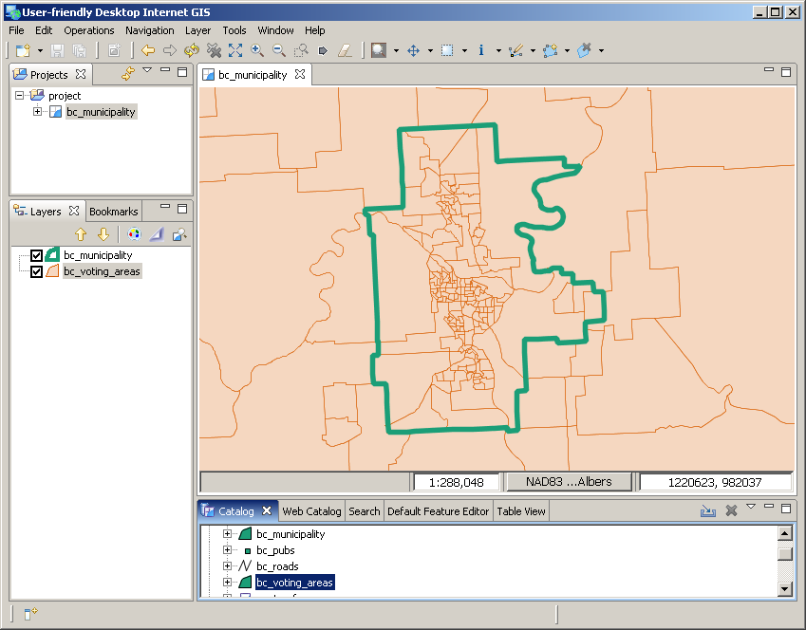
4.4 - Overlays
Notes:
A number of spatial aggregate functions are available:
intersection(geometry, geometry)
Returns a geometry that represents the point set intersection of the given geometries.
symdifference(geometry, geometry)
Returns a geometry that represents the point set symmetric difference of the first geometry with the second.
geomunion(geometry, geometry)
Returns a geometry that represents the point set union of the geometries.

Slide 82
4.4 - Overlays
CREATE TABLE pg_voting_areas AS
SELECT
ST_Intersection(v.the_geom, m.the_geom)
AS intersection_geom,
ST_Area(v.the_geom) AS va_area,
v.*,
m.name
FROM
bc_voting_areas v,
bc_municipality m
WHERE
ST_Intersects(v.the_geom, m.the_geom) AND
m.name = ‘PRINCE GEORGE’;
Notes:
A number of spatial aggregate functions are available:
ST_Intersection(geometry, geometry)
Returns a geometry that represents the point set intersection of the given geometries.
ST_Symdifference(geometry, geometry)
Returns a geometry that represents the point set symmetric difference of the first geometry with the second.
ST_Union(geometry, geometry)
Returns a geometry that represents the point set union of the geometries.

Slide 83
4.4 - Overlays
A quick check …
  Area of overlay should be same as area of clipping polygon
SELECT Sum(ST_Area(intersection_geom))
FROM pg_voting_areas;
SELECT ST_Area(the_geom)
FROM bc_municipality
WHERE name = ‘PRINCE GEORGE’;
Notes:
This query creates a new table containing the municipality name (Prince George), all attributes from the bc_voting_areas table, the intersection between voting areas and municipalities, and the area of the intersection polygon.

Slide 84
4.5 - Coordinate Projection
View the SRID of geometries using the ST_SRID() function
SELECT ST_SRID(the_geom)
FROM bc_roads
LIMIT 1;
What’s “3005”?
SELECT srtext
FROM spatial_ref_sys
WHERE srid = 3005;
Ah, it’s “BC Albers”
Notes:
aka. BC Albers.

Slide 85
4.5 - Coordinate Projection
PROJCS[“NAD83 / BC Albers",
GEOGCS["NAD83",
DATUM["North_American_Datum_1983",
SPHEROID["GRS 1980",6378137,298.257222101]],
PRIMEM["Greenwich",0],
UNIT["degree",0.01745329251994328],
AUTHORITY["EPSG","4269"]],
PROJECTION["Albers_Conic_Equal_Area"],
PARAMETER["latitude_of_center",45],
PARAMETER["longitude_of_center",-126],
PARAMETER["standard_parallel_1",50],
PARAMETER["standard_parallel_2",58.5],
PARAMETER["false_easting",1000000],
PARAMETER["false_northing",0],
UNIT["metre",1],
AUTHORITY["EPSG","3005"]]
Notes:
aka. BC Albers.

Slide 86
4.5 - Coordinate Projection
What’s “3005” again?
SELECT proj4text
FROM spatial_ref_sys
WHERE srid = 3005;
+proj=aea +ellps=GRS80 +datum=NAD83 +lat_0=45.0 +lon_0=-126.0
+lat_1=50.0 +lat_2=58.5
+x_0=1000000 +y_0=0
PROJ4 is coordinate re-projection library used by PostGIS
Notes:
aka. BC Albers.

Slide 87
4.5 - Coordinate Projection
Coordinate Re-projection is done using the ST_Transform() function
SELECT ST_AsText(the_geom)
FROM bc_roads
LIMIT 1;
SELECT
ST_AsText(
ST_Transform(the_geom, 4326) )
FROM bc_roads
LIMIT 1;
Notes:
aka. BC Albers.

Slide 88
4.5 - Coordinate Projection
MULTILINESTRING((
1004687.04355194 594291.053764096,
1004729.74799931 594258.821943696))
ST_Transform(the_geom)
MULTILINESTRING((
-125.9341 50.3640700000001,
-125.9335 50.36378))

Slide 89
4.6 - Advanced Exercises
What is the length in kilometers of
‘Douglas St’ in ‘VICTORIA’?
SELECT
Sum(ST_Length(r.the_geom))/1000
AS kilometers
FROM
bc_roads r,
bc_municipality m
WHERE
ST_Contains(m.the_geom, r.the_geom) AND
r.name = 'Douglas St' AND
m.name = 'VICTORIA';

Slide 90
4.6 - Advanced Exercises
What two pubs have the most Green Party supporters within 500 meters of them?
SELECT
p.name, p.city,
Sum(v.green) AS greens
FROM
bc_pubs p,
bc_voting_areas v
WHERE
ST_DWithin(v.the_geom, p.the_geom, 500)
GROUP BY p.name, p.city
ORDER BY greens DESC LIMIT 2;

Slide 91
4.6 - Advanced Exercises
What is the latitude of the most southerly hospital in the province?
Hint – The SRID of lat/lon is 4326
SELECT ST_Y(ST_Transform(the_geom,4326))
AS latitude
FROM bc_hospitals
ORDER BY latitude ASC
LIMIT 1;

Slide 92
4.6 - Advanced Exercises
What were the percentage NDP and Liberal vote within the city limits of Prince George in the 2000 provincial election?
SELECT
100*Sum(v.ndp)/Sum(v.vtotal) AS ndp,
100*Sum(v.liberal)/Sum(v.vtotal) AS liberal
FROM
bc_voting_areas v,
bc_municipality m
WHERE
ST_Contains(m.the_geom, v.the_geom) AND
m.name = 'PRINCE GEORGE';

Slide 93
4.6 - Advanced Exercises
What is the largest voting area polygon that has a hole?
Hint – A hole implies more than one ring
SELECT
gid,
id,
ST_Area(the_geom) AS area
FROM bc_voting_areas
WHERE ST_NRings(the_geom) > 1
ORDER BY area DESC
LIMIT 1;

Slide 94
4.6 - Advanced Exercises
How many NDP voters live within 50 meters of ‘Simcoe St’ in Victoria?
SELECT
Sum(v.ndp) AS ndp
FROM
bc_voting_areas v, bc_municipality m,
bc_roads r
WHERE
ST_DWithin(r.the_geom, v.the_geom, 50) AND
ST_Contains(m.the_geom, r.the_geom) AND
r.name = 'Simcoe St' AND
m.name = 'VICTORIA';

Slide 95
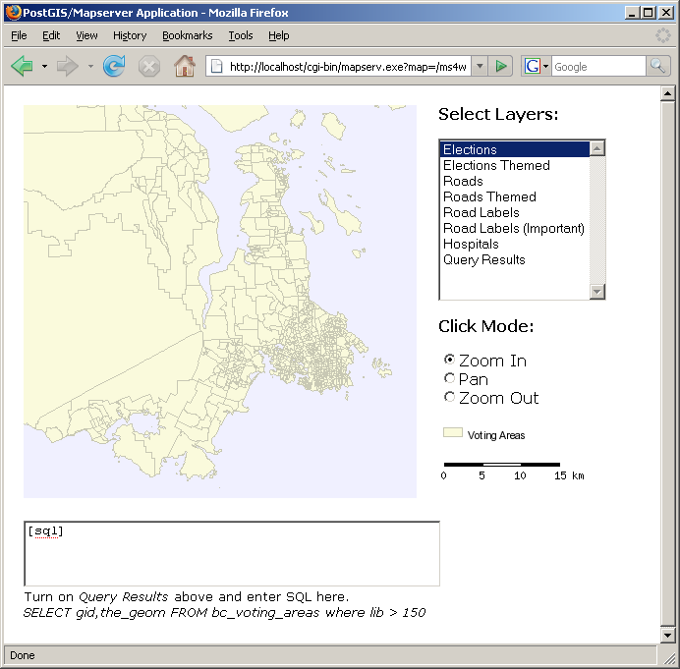
5 Mapserver & PostGIS
http://localhost/postgis
Start the application…
c:\ms4w\apps\postgis\htdocs\template.html

Slide 96
5.1 Basic Configuration
LAYER
CONNECTIONTYPE postgis
NAME "bc_voting_areas”
CONNECTION "user=postgres password=postgres dbname=postgis host=localhost"
DATA "the_geom FROM bc_voting_areas"
STATUS ON
TYPE POLYGON
CLASS
COLOR 255 255 200
END
END

Slide 97
5.2 Filters and Expressions
CONNECTIONTYPE, CONNECTION and DATA elements have unique PostGIS forms
Most other Mapserver map file elements are the same using PostGIS
There are two exceptions:
  FILTER
  EXPRESSION

Slide 98
5.2 Filters and Expressions
For PostGIS connections, FILTER uses SQL “where clause” syntax instead of Mapserver expression syntax.
FILTER “type = 6”
FILTER “name ilike ‘Dunbar%’”
FILTER “age > 6 and height < 4”

Slide 99
5.3 Mapserver with SQL
The Mapserver DATA statement can also use arbitrary SQL to compose spatial result sets for mapping.
Useful when your data does not quite have the information you want to map, but it can be calculated or derived.

Slide 100
5.3 Mapserver with SQL
“Map the % voter turnout.”
DATA "the_geom from
(SELECT gid, the_geom, (case when vregist = 0 then 0.0 else vtotal::real / vregist::real end) AS percent FROM bc_voting_areas)
as foo using srid=3005
using unique gid"

Slide 101
5.3 Mapserver with SQL
“Label the ‘important’ roads.”
DATA "the_geom from (SELECT name,
Sum(Length(the_geom)) AS length,
Collect(GeometryN(the_geom,1))
AS the_geom FROM bc_roads WHERE
the_geom && setsrid(!BOX!,3005)
GROUP BY name
ORDER BY length DESC
LIMIT 5) as foo
using SRID=3005, using unique name"

Slide 102
5.4 - Dynamic SQL
Take advantage of Mapserver %variable% substitution in CGI program
Fill out SQL values on the fly to create new query result sets for mapping
Very powerful tool, very easy to make use of

Slide 103
5.4 - Dynamic SQL
DATA "the_geom from
(SELECT the_geom,gid, ST_Distance(the_geom, SetSRID(MakePoint(
%mx% + %img.x% * %mw% / %iw%,
%my% - %img.y% * %mh% / %ih%), 3005)) AS dist FROM bc_roads)
as foo using srid=3005 using
unique gid

Slide 104
5.4 - Dynamic SQL

Slide 105
5.5 - Very Dynamic SQL
Take the SQL insertion trick to its logical conclusion
Provide a way to visualize arbitrary SQL queries on a map on the fly
Using only the Mapserver CGI and a template based interface
See the qlyr LAYER entry at the end of the example map file

Slide 106
5.5 - Very Dynamic SQL
DATA statement
DATA "the_geom from (%sql%) as foo using SRID=3005 using unique gid"
Template line
<textarea name="sql" rows=3 cols=50>[sql]</textarea>
Only trick is choice of Mapserver LAYER “TYPE”
  Arbitrary SQL can return any geometry type

Slide 107
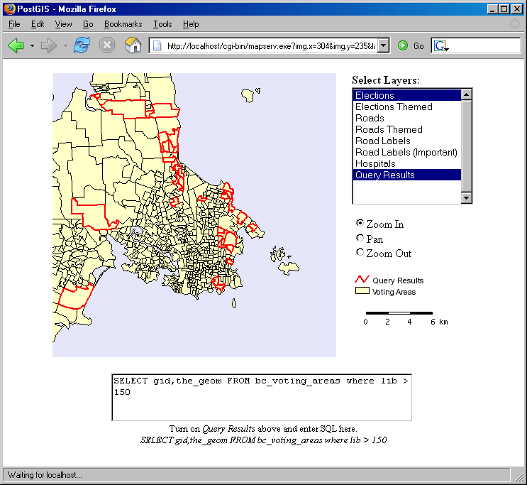
5.5 - Very Dynamic SQL
Enter a SQL query and see it on the map outlined in red

Slide 108
5.5 - Very Dynamic SQL
Try some examples:
All roads that start with ‘B’
SELECT gid, the_geom
FROM bc_roads
WHERE name LIKE ‘B%’
All roads that are longer than 100 metres
SELECT gid, the_geom
FROM bc_roads
WHERE ST_Length(the_geom) > 100

Slide 109
5.5 - Very Dynamic SQL
Buffered voting areas with Liberal
vote > 100
SELECT
gid,
ST_Buffer(the_geom,250) AS the_geom
FROM bc_voting_areas
WHERE liberal > 100

Slide 110
5.5 - Very Dynamic SQL
All roads inside the city of Victoria
SELECT r.gid, r.the_geom
FROM
bc_roads r,
bc_municipality m
WHERE
ST_Contains(m.the_geom, r.the_geom)
AND m.name = ‘VICTORIA’

Slide 111
Thank You …
Ulanbek Turdukulov
turdukulov@itc.nl
PostGIS
http://www.postgis.org
Mapserver
http://mapserver.gis.umn.edu

